Slide 1
APUSH Review

Slide 2
World System: Who’s #1..?
SPAIN: 1492-1550
DUTCH: 1550s-1650s
ENGLAND/FRANCE: 1650s-1763
(1763 - Seven Years’ War ends: the French are out)
ENGLAND: 1763-1918
(financial center of the world: London to NYC)
UNITED STATES: 1918-

Slide 3
COLUMBIAN EXCHANGE
OLD (Europe)
Horse, cattle, pigs, sheep, chicken, wheat
Advanced in animal domestication
Disease: smallpox
NEW (Americas)
Maize, tubers, tomatoes, squash, turkey, legumes, cacao, tobacco, peppers
complex carbohydrates
Disease: syphilis

Slide 4
SPAIN
New Spain
Established largest colonial empire in the New World
Gold & Silver
Catholic: missionaries to covert natives
By 1650: 400,000 Spaniards have migrated to the New World

Slide 5
THE DUTCH
(…or Holland..or The Netherlands)
New Netherland
Henry Hudson
New Amsterdam (Manhattan Island)
The Dutch have the best ships
Sugar & African Slaves

Slide 6
FRANCE
New France: Quebec (Canada) & Nova Scotia
Ohio River Valley
Southern Louisiana (New Orleans)
Fur trade
Most cooperative relationship with Native Americans

Slide 7
ENGLAND
The Delay: Protestant Reformation
  (so internal conflict delays England, but then it will help bring Englishmen b/c they want to avoid this strife and conflict in England)
The mythical Northwest Passage

Slide 8
Southern Colonies:
Virginia i.e. Chesapeake Bay
Jamestown: tobacco
Joint-stock company
Headright System
Indentured Servants
Slavery
Virginia House of Burgesses

Slide 9
Massachusetts Bay
(New England Colonies)
VS.
Chesapeake Bay
(Virginia/Southern Colonies)

Slide 10
New England
Social:
  Towns (town meetings)
  Family-oriented: women and children
  Common purpose and religious goals
  Schools
Theocracy:
  church very powerful
  Intolerant
Economics:
  trade, fishing, ship building

Slide 11
Chesapeake Bay
Plantations
Mostly men
Relied on slavery
More like a business
Children ‘schooled’ at home
Spread out, rural (counties)

Slide 12
MIDDLE COLONIES
Proprietary colonies
Pennsylvania Colony:
  William Penn: Quaker
  “Inner Light” salvation
  “The Holy Experiment”
  Religious Tolerance/Freedom
  Diversity: Germans, Dutch, Scottish, etc.
  Philly: grid plan, town squares, parks

Slide 13
Bacon’s Rebellion 1676
Nathaniel Bacon
Virginia Governor William Berkeley
Indians
Clash between east/west, rich/poor
Revision of indentured servants and more reliance on slave labor

Slide 14
The Great Awakening
American UNITY within churches’ disunities
Pattern: defiance of religious authority will help lead to defying royal authority…

Slide 15
Great Awakening continued…
Jonathan Edwards
  New England
  Argued God was angry with our sinfulness. But if express deep penitence, you will be given God’s grace.
George Whitefield
  Brought message to all colonies
  Dynamic, rousing sermons
  Preached in barns, tents, fields
  Abolitionist, Methodist

Slide 16
How did it happen that thirteen colonies on the fringe of civilization, as it were, with perhaps half a million males of fighting age, without military resources, without leaders, without even a national government, a national army, a national treasury, brought the mightiest of European powers to its knees, and wrung from it concessions beyond the avarice of conquerors
- Henry Steele Commager

Slide 17
Loyalist
Moderates
Patriots

Slide 18
Treaty of Paris (1783)
Recognition
All territory east of the Mississippi River
Fishing rights off Newfoundland
Both sides collect debts from citizens in the other country (legitimate debts still stood)
Congress would return confiscated property to British subjects (realistically didn’t happen)

Slide 19
Creation of the
U.S. Constitution
The AOC (Articles of Confederation) were unable to address the economic and political problems facing the new nation
The Constitution was completed only b/c the delegates at the convention were able to reach a # of major compromises.

Slide 20
Opposition to ratification of the Constitution came from antifederalists, who feared a strong central government.
Promise of a bill of rights was important to ratification of the Constitution.

Slide 21
Shays’s Rebellion
Aug. 1786 - Feb. 1787
Considered a pivotal event in the decision to reform the AOC
Frustration over farmers’ debts and foreclosures led to revolts against the courts of Massachusetts
Mass legislature did not enact the economic policies of easy money/credit
Revealed AOC govt’s inability to deal with major economic problems

Slide 22
Constitutional Convention
Difficulty: design a strong central government while protecting individual liberties
The Virginia Plan went well beyond just revising the AOC (Edmund Randolph)
James Madison:
George Mason:

Slide 23
Federalists
Support: mainly coastal and urban areas and upper classes - merchants, financiers, shippers, planters, though not all upper-class citizens were Federalists
Leaders: Hamilton, Madison, and Franklin
Strong central government = peace, stability and strong Union (the AOC could not provide these).

Slide 24
Antifederalists
Support: mainly rural areas and those philosophically opposed to a strong central government.
Leaders: Patrick Henry, John Hancock, and George Mason
Central gov’t did not guarantee protection of ind. rights.

Slide 25
Ratification of the Constitution
Federalist Papers
Feds argument: 3 branches/checks & balances limited potential for abuse of power
The promise to add a bill of rights

Slide 26
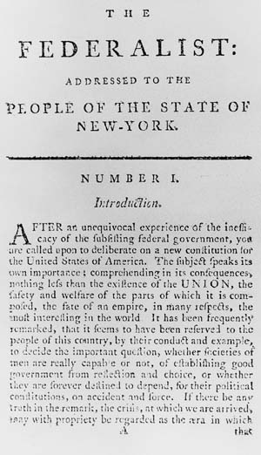
Hamilton effort to win over his home state (NY)
Defended the Constitution
Explains the complexities of a Constitutional government

Slide 27
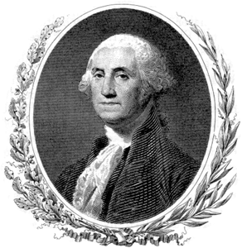
GW

Slide 28
Domestic Policy
cabinet
Judiciary Act of 1789: created the Supreme Court and a lower federal court system (giving greater definition to the judicial branch)
Economic Plan
Whiskey Rebellion

Slide 29
Hamilton’s Economic Plan
Tariff of 1789 - designed to protect domestic manufacturing & raise revenue
Report on Public Credit
Creation of a national bank

Slide 30

Rebellion
Reaction to tax on whiskey
Western Penn.
6,000 Whiskey Rebels
12,000 federalized militia (from Penn, MD, VA, & NJ)

Slide 31
GW
“I believe scarcely any thing, short of a Chinese Wall, or a line of troops, will restrain land jobbers and the encroachment of settlers upon the Indian Territory”

Slide 32
Foreign Affairs
Proclamation of Neutrality
Jay’s Treaty
Pinckney’s Treaty
Treaty of Greenville (after Battle of Fallen Timbers (NW Territory)

Slide 33
Proclamation of Neutrality
GW, 1793
Warfare between Britain and France complicated U.S. politics.
Britain: still had forts in NW Territory, as well as seizing Am. ships and impressing Am. sailors.
France: Genet trying to get Am. aid for French Revolution

Slide 34
Jay’s Treaty
John Jay
Britain promised to remove troops from the NW Territory
On every other point of dispute, however Jay agreed to British terms
No mention of impressments
D-Rs denounce it as a “sellout” of American rights

Slide 35
Pinckney’s Treaty
Spain opened up the Mississippi and New Orleans for U.S. trade and shipping
Spain was nervous - thought Jay’s Treaty was an alliance between U.S. and Britain

Slide 36
GW’s Accomplishments
Showed the new government could control its most distant regions
Secured the homeland/homefront from threats: Britain, Spain, and Native Americans

Slide 37
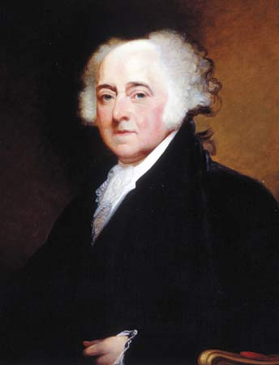
John Adams

Slide 38
Foreign Policy
France breaks off relations with the U.S. after Jay’s Treaty
XYZ Affair
Quasi-War: period of increased hostility between France and the U.S. (1798-1800)

Slide 39



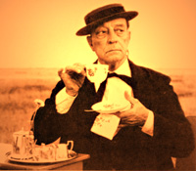
vs.
D-Rs
Feds

Slide 40
XYZ Affair
France now harassing American ships at sea
Main foreign affairs issue between both Britain and France: seizing ships (disrupted trade and economic growth)
French officials demanded U.S. commissioners pay $250,000 “tribute” or bribe

Slide 41
Quasi-War: period of increased hostility between France and the U.S. (1798-1800)

Slide 42
Domestic Policy
Alien and Sedition Acts
Midnight Judges

Slide 43
Alien Acts
directed towards immigrants
naturalization increased from 5 to 14 years
The president can detain aliens during wartime or deport any alien deemed dangerous to the U.S.
More new immigrants tended to support the Democratic-Republicans...

Slide 44
Sedition Act
speaking, writing, or publishing criticisms of the gov’t were illegal (at the very least misdemeanors and possibly treasonous)
An attempt to silence opposition, the D-Rs (neutralize any challenges to their dominance)
backfired on the Federalists

Slide 45
KY & VA Resolves
D-Rs’ reaction to A & S Acts
TJ & Madison
States have the right to interpret federal law and declare a federal law null and void if they believe it unconstitutional.

Slide 46
“The Revolution of 1800”
Feds and D-Rs: each side believed its defeat in 1800 would mean the end of the republic
TJ
Feds - internal disputes
peaceful and orderly transfer of power
“We are all Republicans, we are all Federalists.”

Slide 47
TJ Presidency
reduced army, spending, national debt…
Embargo Act (“economic coercion”) hurt New Englanders the most (trading)
Louisiana Purchase

Slide 48
Judicial Review
John Marshall - Supreme Court Chief Justice
Adams’ and Federalists’ lasting legacy
“midnight judges”
Marbury v. Madison (1803) - est. the S.C.’s power to decide whether laws are constitutional or not.

Slide 49
Decline of the Federalists
Feds want to declare war on France
“High Federalists”:
Fed. internal debate: army or navy
Hamilton appointed commander of U.S. Army - fear he will use army to impose taxes and A & S Acts and form alliance with Britain.
Adams calls for peace talks with France: splits Fed party (and costs him his chances for re-election)

Slide 50
The War of 1812
2nd War for Independence
Fight for our right to be neutral - Freedom of the Seas
British impressments
Further divided Feds and D-Rs (Hartford Convention)
Treaty of Ghent: status quo ante bellum
American nationalism intensified

Slide 51
Monroe Doctrine
Avoid European wars unless American interests were involved
"American continents are not subjects for future colonization by any European power"

Slide 52
Henry Clay’s American System
tariff, bank, internal improvements
Goal: create a specialized, interdependent national economy
Clay hoped to resolve sectional differences by giving something to each section

Slide 53
Market Revolution

Slide 54
Election of 1824
J.Q. Adams – carried New England
Andrew Jackson– carried almost every state outside New England
“The Corrupt Bargain”:

Slide 55
Jacksonian Democracy
Represented a return to the principles of Jefferson
Jacksonians:
  Glorified individualism
  Vowed to restrain the federal gov’t
  Promoted states’ rights
  Looked out for the interests of southern and western farmers
States dropped property requirements for voting
Claimed to protect democracy from the forces of corruption and privilege

Slide 56
Jacksonian Democracy
Commitment of the Jefferson ideal of an agrarian society
Dislike of the concentration of power, both economic and political
Drive to restore independence of the individual
Hostile to reform because it meant intervention and activism by the federal government
Restoration of “Republican” virtues, such as hard work and frugality, self-reliance, and self-discipline
Belief that any man could fill any role in gov’t

Slide 57
Spoils System
“To the victor belong the spoils” = Jackson’s policy of giving gov’t positions to his friends and supporters, believed special training and education not necessary to hold a gov’t position

Slide 58
Tariff of Abominations (1828)
Proposed by Jackson supporters in Congress during Adams’ admin.
Expected it to fail b/c high duties placed on both manufactured goods (desired by the South) and wool (needed by New England mills)
Believed New England states would vote it down and this would seem as if Congress is going against Adams and supporting Jackson
When it was passed, flags flew at half-mast in Charleston

Slide 59
Nullification Crisis
Tariff of 1832: Passed before election of 1832
Did not reduce 1828 duties substantially
A state convention in S.C. declared it null and void, if fed. gov’t tried to enforce the tariff in S.C. the state would secede from the Union
Jackson, re-elected in 1832, declared that no state had the right to secede and that any attempt to do so would be met with force.
Jackson appealed to people of S.C. to obey national law saying any attempt would be met with force
Jackson obtained authority from Congress (Force Act) to enforce laws any way necessary (send troops)

Slide 60
Nullification Crisis continued…
Jackson issued a proclamation nullifying nullification (said it was an act of treason)
Strengthened federal forts in S. Carolina
Privately worked to pacify S.C. and changed the tariff
Calhoun resigned as VP and became a Senator from S.C.

Slide 61
War Over U.S. Bank

Slide 62
The 2nd Bank
Bank’s 20-year charter would expire in 1836
Served as depository for fed. funds
Bank notes circulated as currency and could be exchanged for gold
Clearinghouse for state banks, refusing to accept their notes if they had insufficient gold in reserve

Slide 63
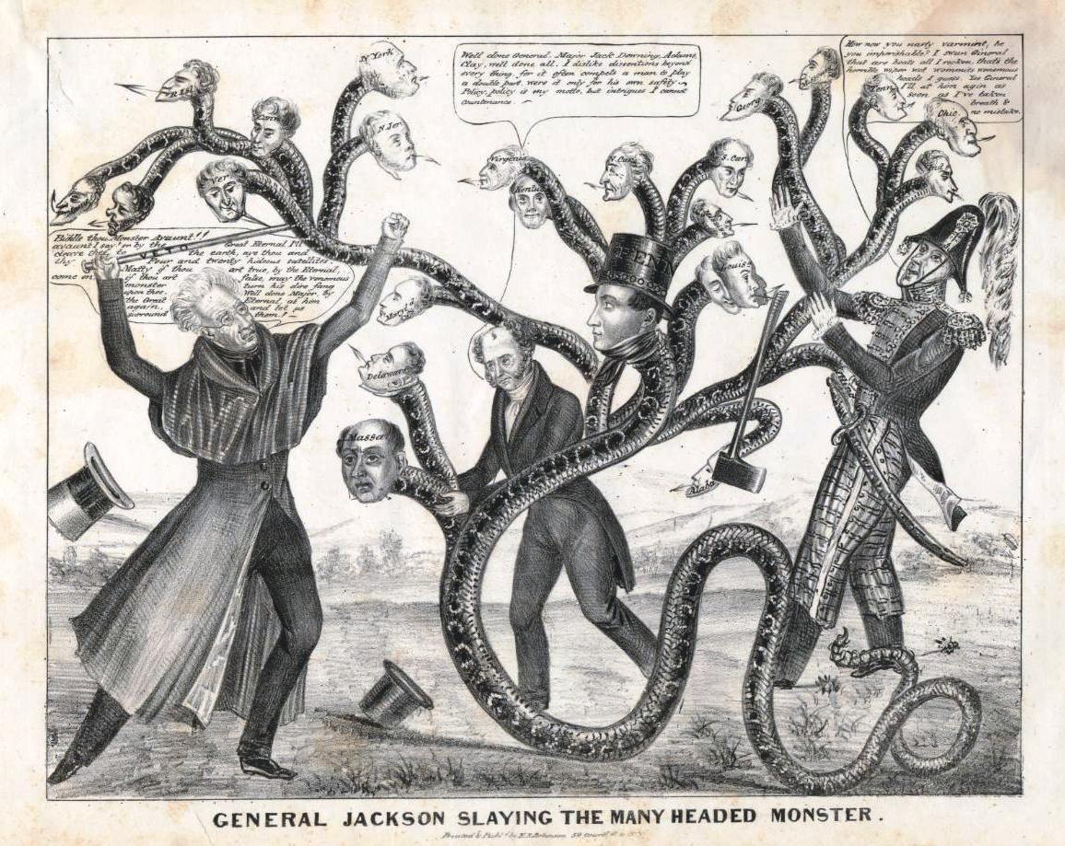

Slide 64
Enemies/distrust of The Bank
State banks resented the police role of the U.S. bank; it restricted amount of $ state banks could issue
State banks could not compete since they had less $ in reserve
Said U.S. Bank unresponsive to local needs.
Jackson – feared bank gave special privileges to a few and disliked fed. intervention & activism
West:
  When the bank withdrew money to stabilize the dollar it = lower farm prices and foreclosures on farm mortgages

Slide 65
Effects of the Bank Veto
Inflation
Specie Circular: federal land purchases must be paid in gold or silver coin
Panic of 1837: Gold/silver depleted, banks couldn’t make payments and the economy collapses

Slide 66
Maysville Road Bill
Vetoed by Jackson
Jackson believed internal improvements to be a state responsibility
AJ’s trend of going against Clay’s American System

Slide 67
Development of the Whig Party
Reaction to Jackson – “King Andrew I”
Bank controversy – AJ killing the 2nd Bank
AJ’s frequent use of the veto
States’ Rights vs. Federal Power
Need all parts of the American System for economic success

Slide 68
Political Campaigns in Election of 1828
Focused on winning support of the people; appeal
Nominating Convention replaces caucuses
Anti-Masonic Party (3rd party) adopted the party platform and conventions

Slide 69
Pursuit of Perfection: Era of Reform

Slide 70
Sources of Reform
Government: policies and legislation furthering democracy
Grassroots movements: individuals, private groups, classes, and organizations

Slide 71
Second Great Awakening
Religious revivals
Reaction to Enlightenment’s reliance on reason over faith
Taught that Christians could transform society by working for justice

Slide 72

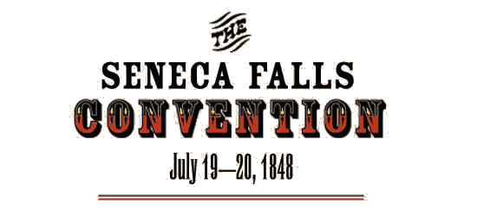
Women’s Rights
Seneca Falls, New York, 1848
“Declaration of Sentiments”
Elizabeth Cady Stanton and Lucretia Mott
Very involved in abolitionist movement
Discontent for subjugation

Slide 73
Abolitionists
Call for the immediate emancipation of slaves
Frederick Douglass
John Brown
William Lloyd Garrison: newspaper - The Liberator

Slide 74
Education
Public school reform
Horace Mann - his Massachusetts model was the basis of a tax-supported public school system

Slide 75
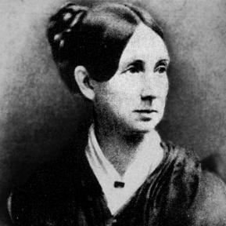
Mental Health
Outrage over barbaric treatment of patients in asylum (mental health (facilities)
Dorothea Dix - led way to better treatment

Slide 76
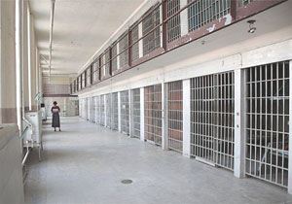
Prisons
Sought more humane treatment of prisoners
Rehabilitation over punishment (humiliation, physical abuse, and neglect)

Slide 77
Utopian Societies
Experiments in furthering moral and spiritual development through cooperative communities
Brook Farm, New Harmony, Shakers, & Oneida Community

Slide 78
Temperance
The War on Liquor
Believed alcohol was interfering with political and social development of the nation
“10 Nights in a Bar-Room”

Slide 79
Transcendentalism
“Transcend” reason and follow your own conscience and intuition.
“Universal brotherhood” - all of humanity, nature, and God are connected
Also, individualism, self-reliance, moralism

Slide 80
American Artists:
Painted American landscapes, animals, birds
Romantic, optimism of the frontier, democracy, etc.

Slide 81
Hudson River School
Romantic depictions of local landscapes
Glorification of the raw power and beauty of American landscapes
Nature = best source of wisdom and fulfillment

Slide 82
View of the Catskills, Early Autumn
Thomas Cole, 1837

Slide 83
Ralph Waldo Emerson
“The American Scholar”: Told Americans to cast off European influences and develop own beliefs
Transcendentalist
Wrote Nature & Self-Reliance

Slide 84
Henry David Thoreau
Wrote about simple life in nature, Walden
Transcendentalist
Urged civil disobedience

Slide 85
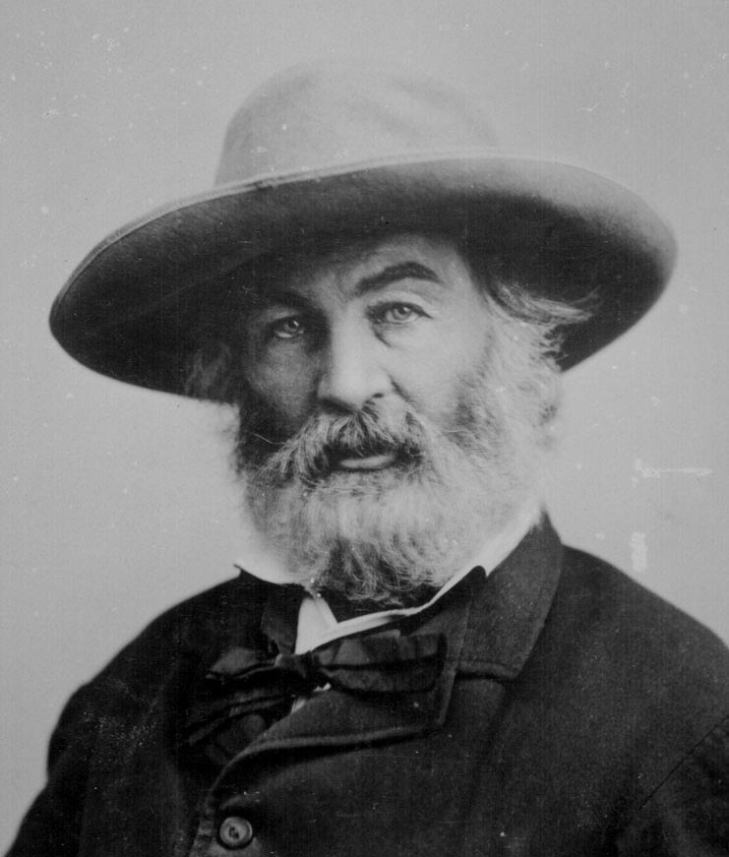
Walt Whitman
Bold, unrhymed poems
Praised ordinary people
Shaped modern poetry
Experiments with language

Slide 86
Causes of the Civil War
Mexican-American War (1846-48)
Compromise of 1850
Uncle Tom’s Cabin (1852
Nebraska-Kansas Act (1854)
Bleeding Kansas (1856)
Dred Scott Case (1857)
John Brown’s Raid (1859)
Election of 1860
South Carolina secedes (1860)

Slide 87
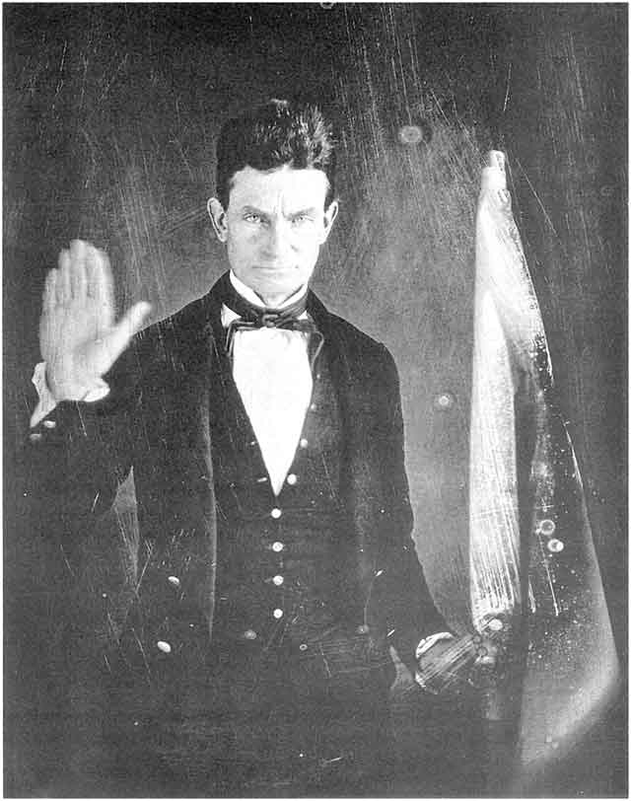

Slide 88
Gettysburg
turning point of the war
considered most famous battle fought on North American soil
Union victory
2nd and last Confederate invasion of the North; high water mark

Slide 89
Gettysburg Address
Lincoln’s most famous speech
Nov. 19, 1863
The war a struggle not merely for the Union, but for “a new birth of freedom”
Ensure that “government of the people, by the people, for the people, shall not perish from the earth”

Slide 90
The Union
Pop: 22 million
Had to conquer the South (offensive war)
More factories; more wealth; diverse economy
Strong central government (including Lincoln)
Generals who understood the nature of “total war” (Grant and Sherman)

Slide 91
The Confederacy
Pop: 6 million whites
Defensive war
Economy underdeveloped; relied on overseas demand for cotton
New and weak central gov’t
Initially getter generals (Lee and Jackson)

Slide 92
Significant Results
Accelerated the industrial revolution
greenbacks
Advances in medicine
Over 600,000 soldiers died
Around 200,000 African-Americans served in the Union armies

Slide 93
Industrial Capitalism
legislation: after secession Congress was w/out Southern representation
war mobilization program
Railroad corporations

Slide 94
Incentives for RRs
Land for every mile built
Grants for every mile built
  $16,000 (in level country)
  $32,000 (in foothills)
  $48,000 (in mountains)

Slide 95
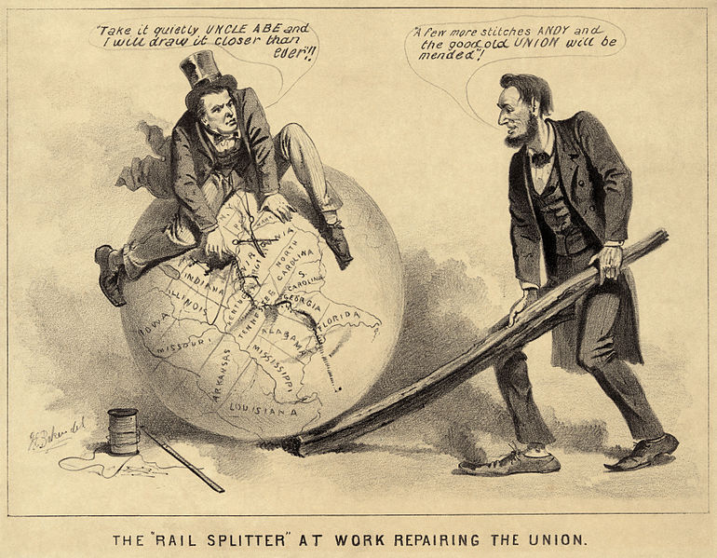

Slide 96
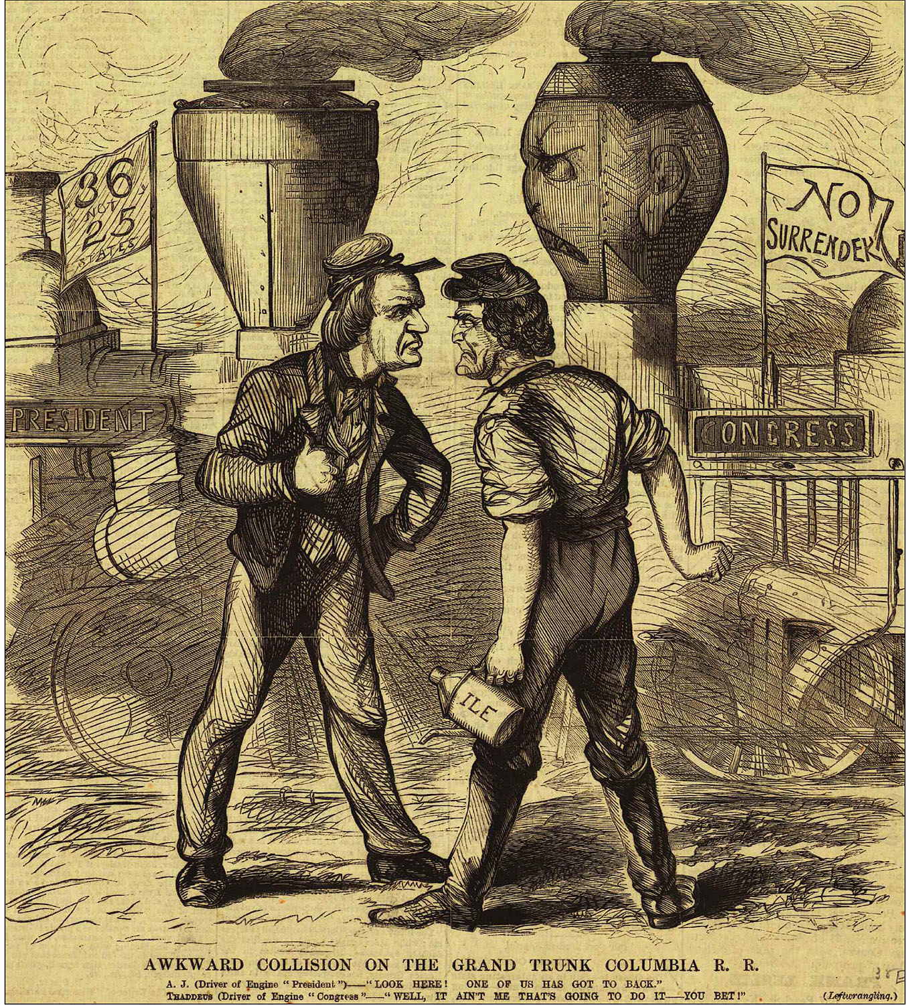

Slide 97
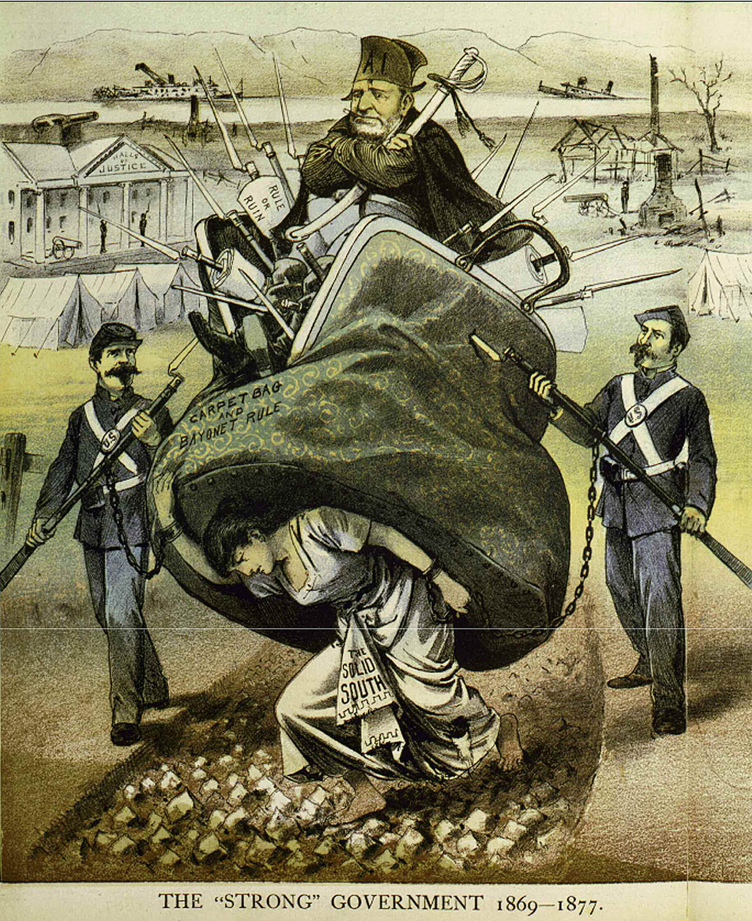

Slide 98
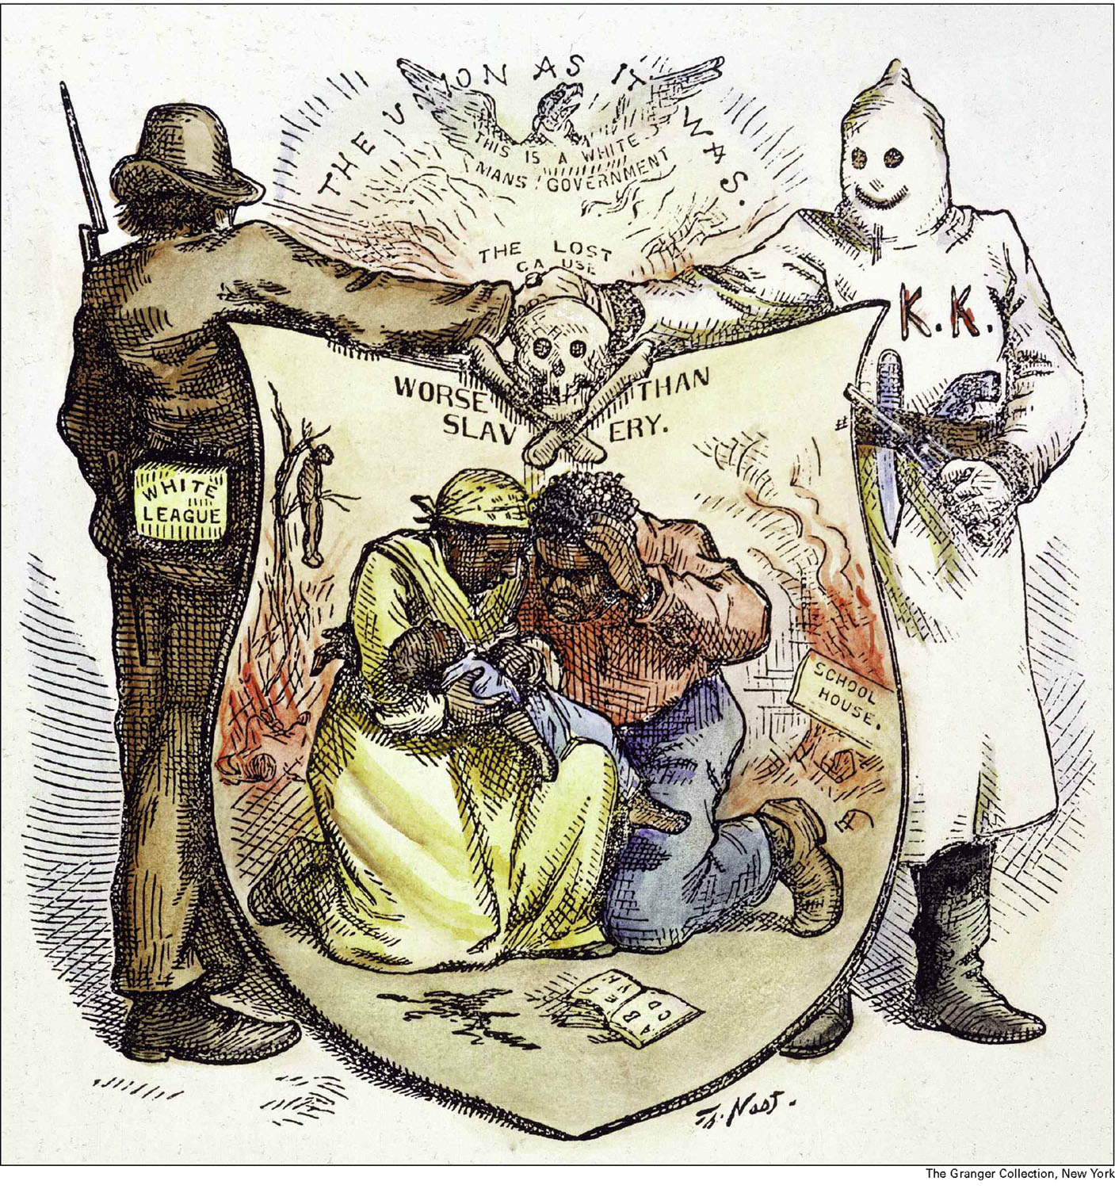

Slide 99
Exodusters
Nickname for African Americans who moved west (technically NW) out of the South to Kansas, Oklahoma, Missouri in the late 1870s

Slide 100
Century of Dishonor
Helen Hunt Jackson

Slide 101
Indian Wars
1860s-1870s: constant warfare and disputes over land ownership
1870s: Outbreak caused by rush of gold miners into Indian territory, U.S. governments attempt to isolate tribes on smaller reservations, perceived failure of the U.S. government to honor past treaty commitments

Slide 102
End of Reconstruction
Most African Americans were tenant farmers
Sharecropping: debt (food, tools, supplies); peonage
After Plessy v. Ferguson (1896):
  Led to the passing of Jim Crow laws
  Miscegenation

Slide 103
Reconstruction’s Legacy
Freedmen’s Bureau
Improving education

Slide 104
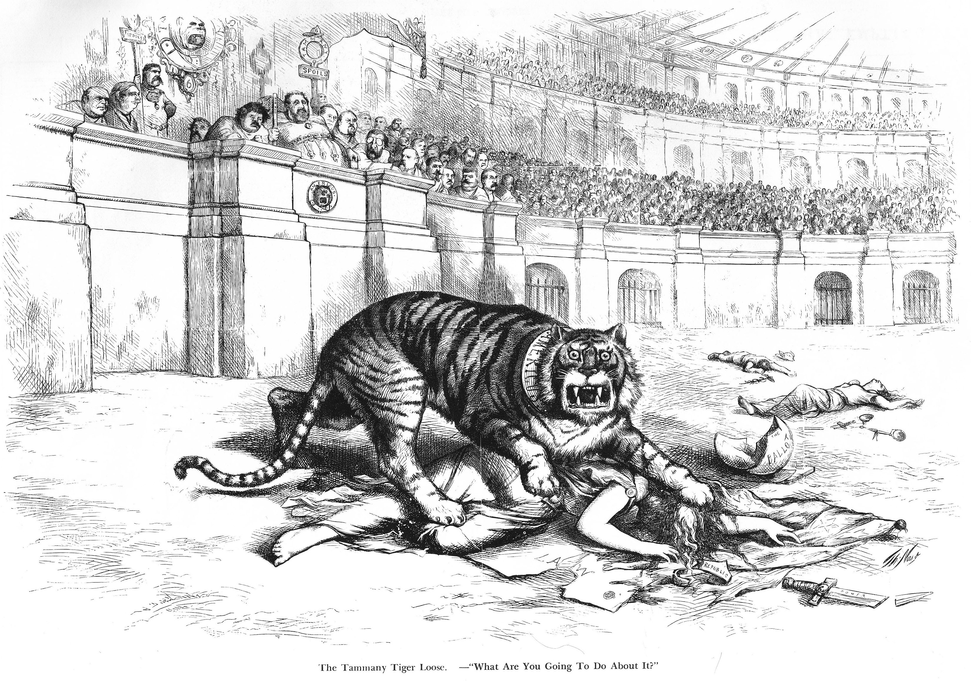

Slide 105
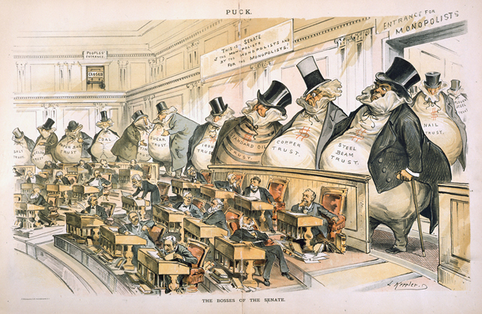

Slide 106
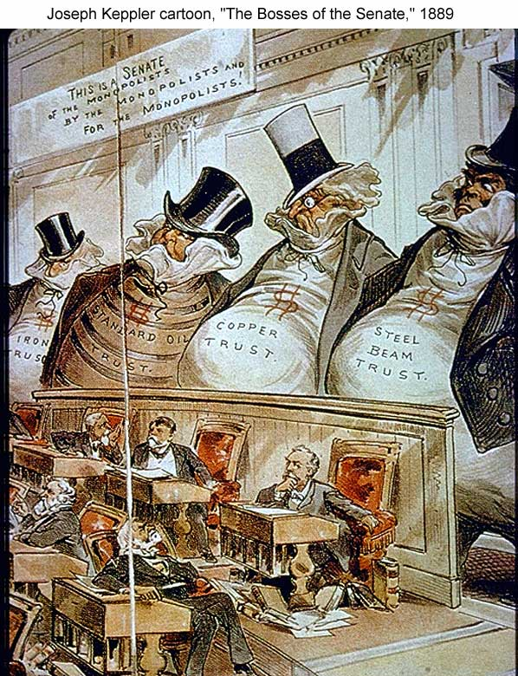

Slide 107
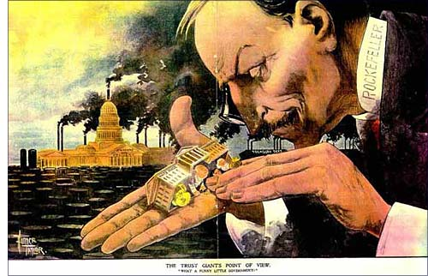
THE TRUST GIANT’S POINT OF VIEW
“What a Funny Little Government”

Slide 108
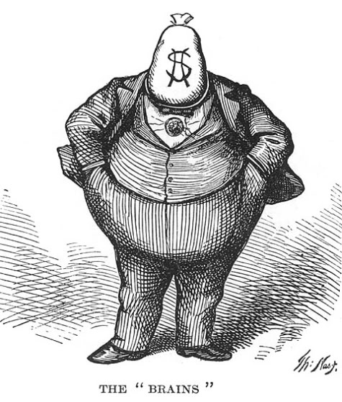
“The Brains that Achieved the Tammany Victory at the Rochester Democratic Convention”

Slide 109
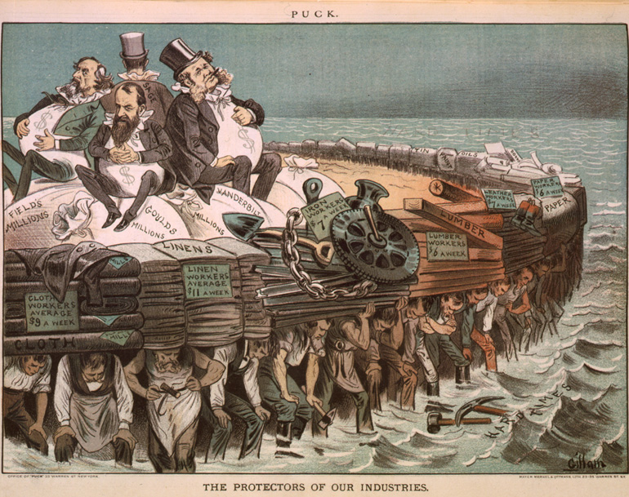

Slide 110
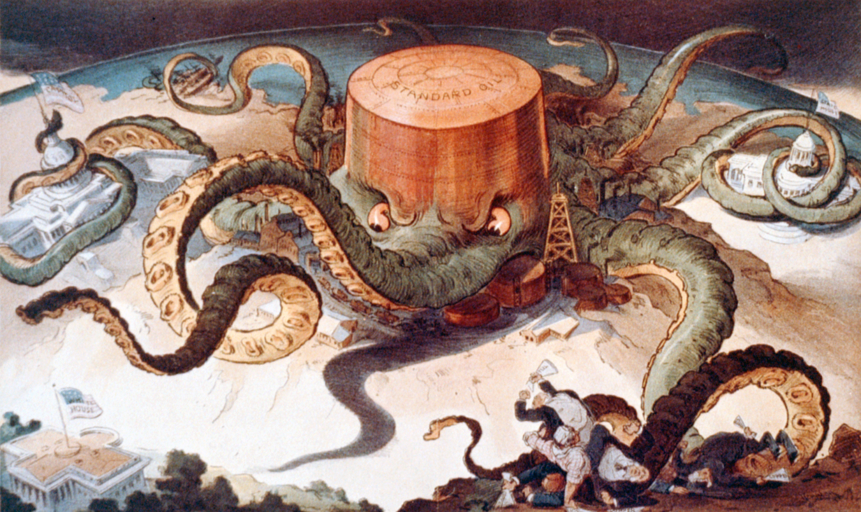

Slide 111
